Slide 1
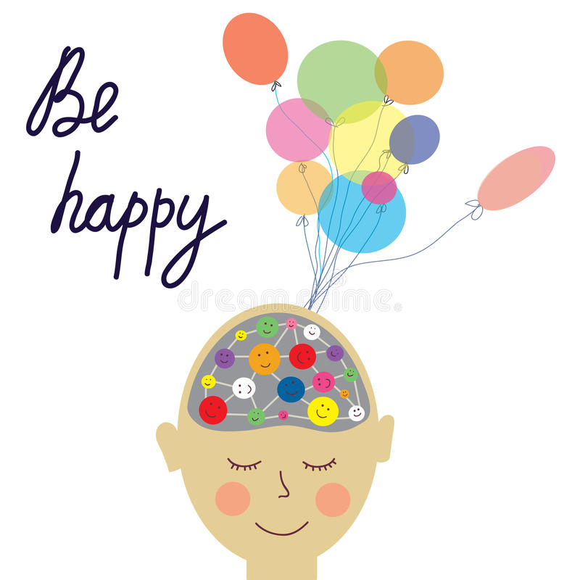
Welcome to wellbeing wednesday!

Slide 2
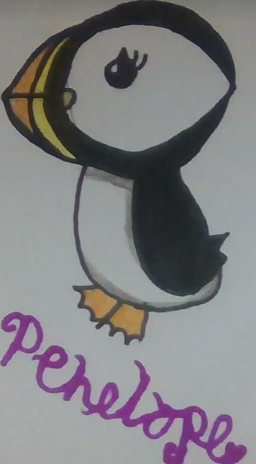
Before we start…
Penelope the Puffin will pop up on my slides… your challenge is to count how many puffins pop up!

Slide 3
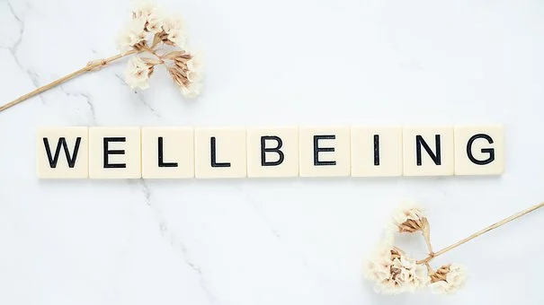
MENTAL HEALTH
AND
TASK 1
What do we already know? What words do you associate with these?
NOTE THEM DOWN

Slide 4
What is Mental Health?
Mental health means being happy all the time.
Read the statements about mental health.
Which do you feel best explains mental health? Have you got a different idea?
Mental health is about feelings and emotions; knowing how to take care of ourselves so that we can cope with things that happen to us.
Our mental health is about our feelings and emotions. People’s mental health can feel better or worse at different times, just like physical health. It is as important to take care of our mental health (minds) as our physical health (bodies).
Mental health means there is something wrong with a person and they might behave in a strange way.
Click on the box to reveal a possible answer
Mental health means that you often feel worried, anxious or depressed.
Mental health is a bit like a continuum – people can move along it and feel better or worse at different times, just like with physical health.

Slide 5
What is Mental Health?
Make it Count: Guide for pupils | Mental Health Foundation
Have a look at this website, which explains what mental health is and things that might affect it

Slide 6
A Simple Mental Health Definition
NHS England describes mental health as:
‘How we think, feel and behave’.

Slide 7
Thinking About Mental Health
Mental health can be thought of as a scale that can move up or down, a bit like a thermometer.
We can move along the scale at any time, between being healthy or unwell.
There are things we can do to help us stay healthy.
There are things that can be put in place if someone is not feeling so good, is struggling or unwell.

Slide 8
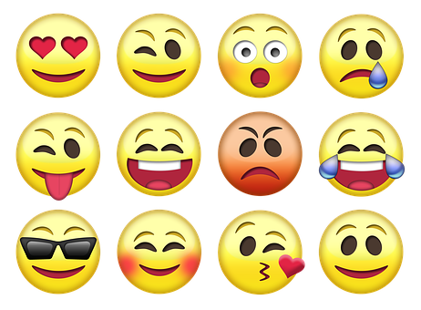
Changing feelings
Emotions and feelings change throughout the day and over time. Taking care of our mental health helps us to manage.
Feelings can grow or get stronger with time.
Some feelings seem to fade or pass over time.
Usually feelings that don’t feel so good, don’t last long.

Slide 9
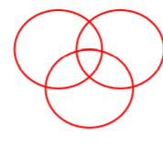
TASK 2
HAPPY
COMFORTABLE
HEALTHY
Draw three circles (as shown above)
label one circle “happy” one “comfortable” and one “healthy”
Write or draw the things that help you feel this way in the circle. NB Some things will make you feel happy and comfortable, or healthy and happy, you can write these things in the spaces where the circles overlap.
When you’ve finished why not reward yourself with a tasty snack!

Slide 10
Time for a break...
Step 1: Click on the link below
Step 2 : Prepare to clap, drum, play air guitar, leap, dance...whatever makes you feel good!
Get ready to ...
rock!
We Will Rock You - YouTube

Slide 11
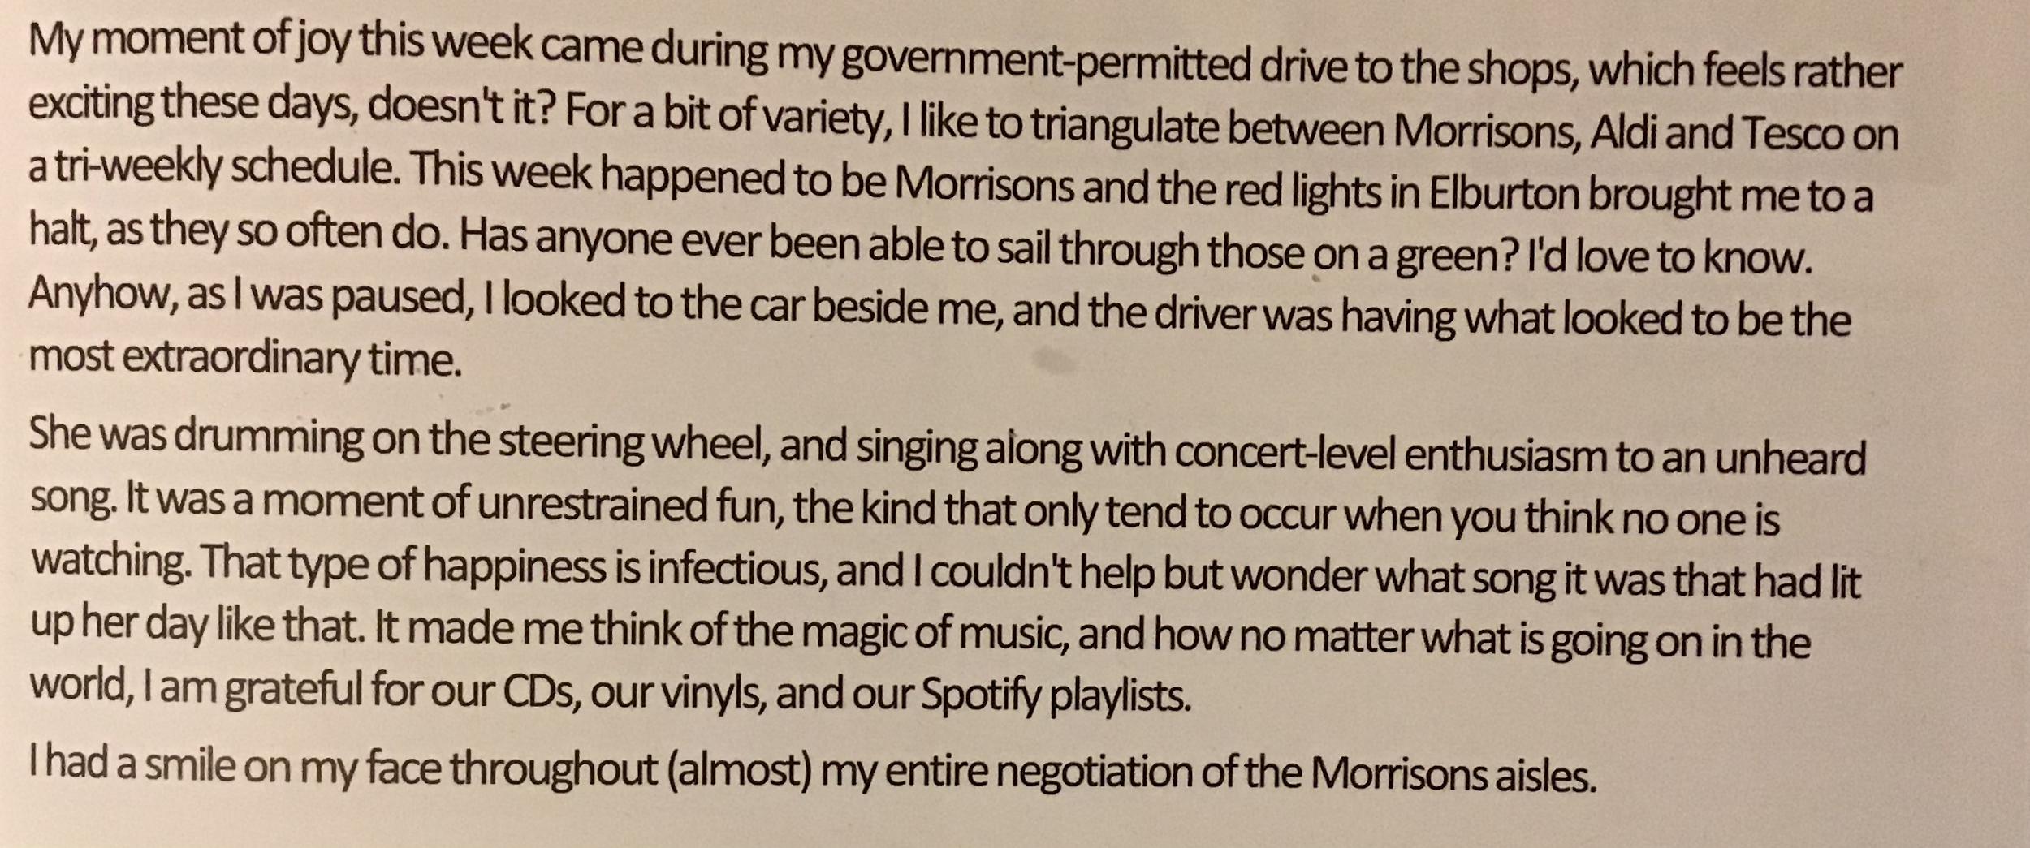
Sometimes you just have to let go and go mad! Guess who the drumming lady in the car was?!
Make list of your wellbeing activities?

Slide 12
Be kind to yourself...
When we are busy, facing challenges or dealing with change, we can forget to consider and take care of our own wellbeing. Looking after yourself is an important part of being resilient and coping with challenges well. It is essential to be kind to yourself.
We need to make time to do the things that make us feel good.

Slide 13
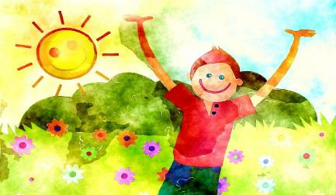
Activities for Health
TASK 3
Look at the resource sheet attached to my post.
Organise the activities into 3 lists:
Things that support mental health
Things that support physical health
Things that support both mental and physical health

Slide 14
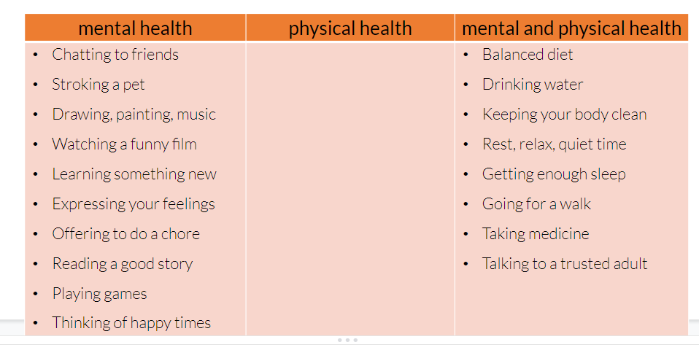
Activities for Health
Your list might look similar to this...

Slide 15
What did we find out?
Answer the next two questions:
There are lots of things we can do to help support mental health.
The things that help physical health also help mental health.
Click here to reveal some things to think about
What do you notice about the lists?
Were there any things that did not help mental or physical health very much or at all?
Click here to reveal some things to think about
Some things, such as eating lots of sweets, are not so good for mental or physical health.

Slide 16
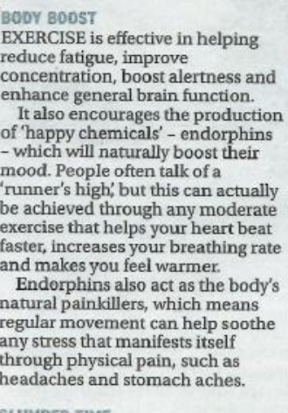
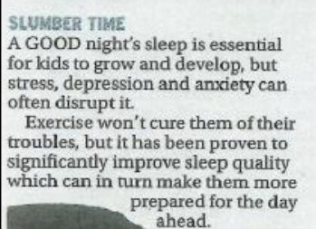
Never underestimate the effects of exercise!

Slide 17
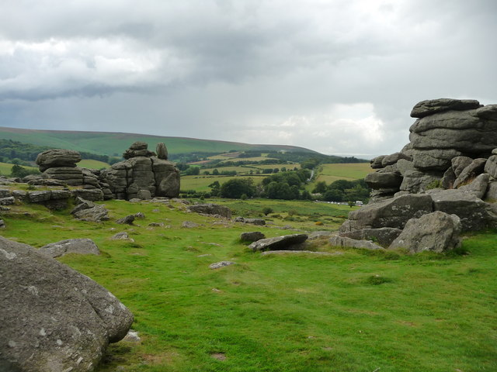
The Great Outdoors
Why is being outside good for our wellbeing?
A break from routine/stress
Sun- vitamin D
Fresh Air
Beauty
Calm
Exercise

Slide 18
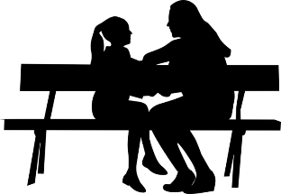
Reflection time
Make a list of things that you could easily do to improve your well being.

Slide 19
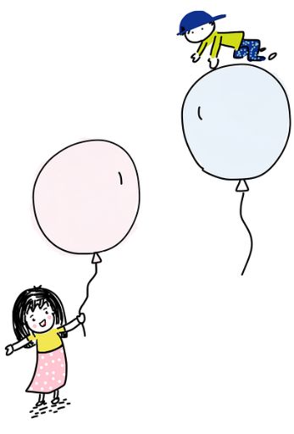
Mental Health – asking for help
Expressing and talking about feelings — especially those that don’t feel so good, seem very strong, or go on for a long time — is an important part of mental health care. It is usual for people to need help with their feelings sometimes.
It’s really important that you share your feelings and ask for help when you need it.

Slide 20
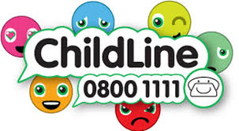
Who Can Help?
Family
Teaching Assistants
NB There’s lots of good advice on the school’s website (see below)
Health and well-being | marydeansprimary (marydeansprimaryschool.co.uk)
Parents
Carers
Friends
Teachers

Slide 21
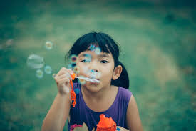
To finish let’s ...Blow Bubbles!
Sometimes we are so full of emotion we can’t think very well. There are many things we can do to help us so that we can then think more clearly and start to understand what we are feeling and thinking. One activity is the ‘blowing bubbles’ breathing exercise.
Sit somewhere quiet or close your eyes. Imagine you have a bottle of bubbles, or if you have some real ones, blow some real bubbles. Gently blow a bubble and watch it float away. Breathe in and then blow another bubble out. Keep blowing bubbles until you feel better. Does an activity like this help you? How does it help?
If you prefer you could do some Square Breathing

Slide 22
How many puffins did you spot…
The answer is…

Slide 23
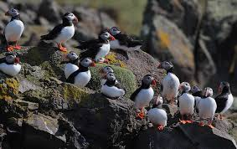
12

